Slide 1

Teach-Me
Project Code: https://github.com/OrelDamti/Teach-Me
Capstone project phase B​
Supervisor: Prof. Zeev Barzily
Students: Orel Damti and Ilan Vinerski

Slide 2

Road Map
Introduction
Solution
Product
Verification
Demonstration
Conclusions

Slide 3



Introduction
The price for a private teacher is very expensive.
The material does not always overlap between the student and the teacher.
Many students get help by private teacher during his studies.

Slide 4
Our solution
Our solution
“TeachMe” is a web application that enables students to be helped by students from higher years, who have already passed these courses with a high grades and charge a fair price for a private lesson. In this way, students will be able to earn money during their studies, and on the other hand, students who need help in their studies will have the opportunity to receive help at a price they can afford.

Slide 5
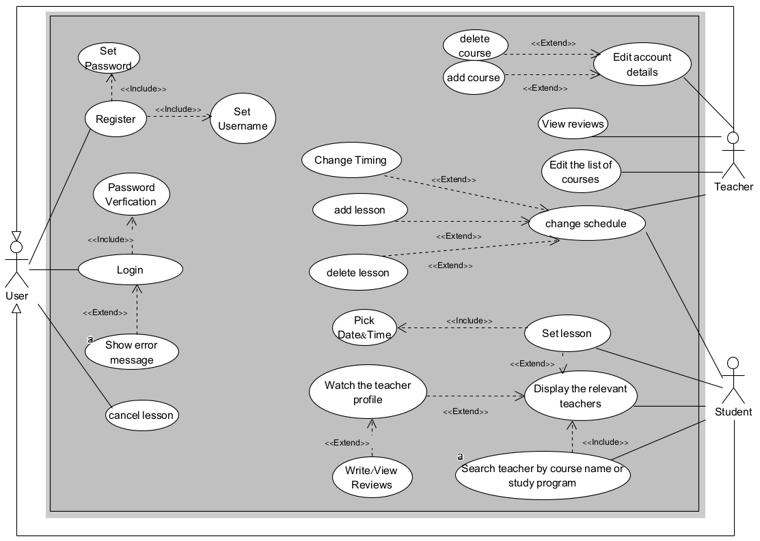
The Product`s
UseCase
diagram

Slide 6
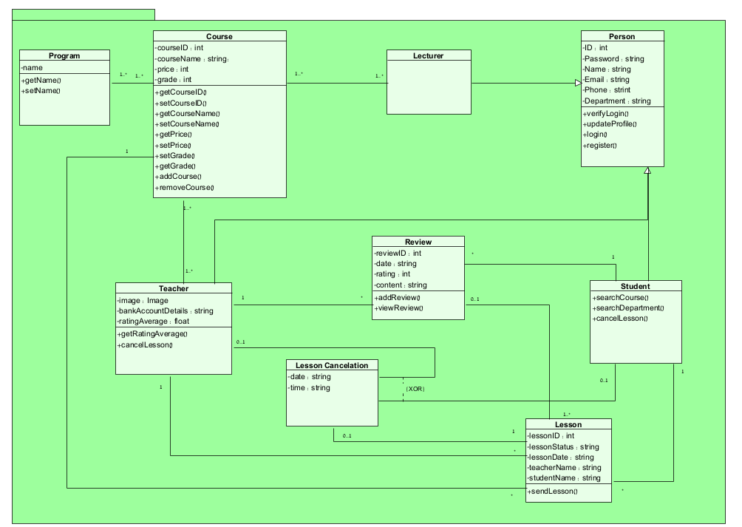
The Product`s
Class diagram

Slide 7
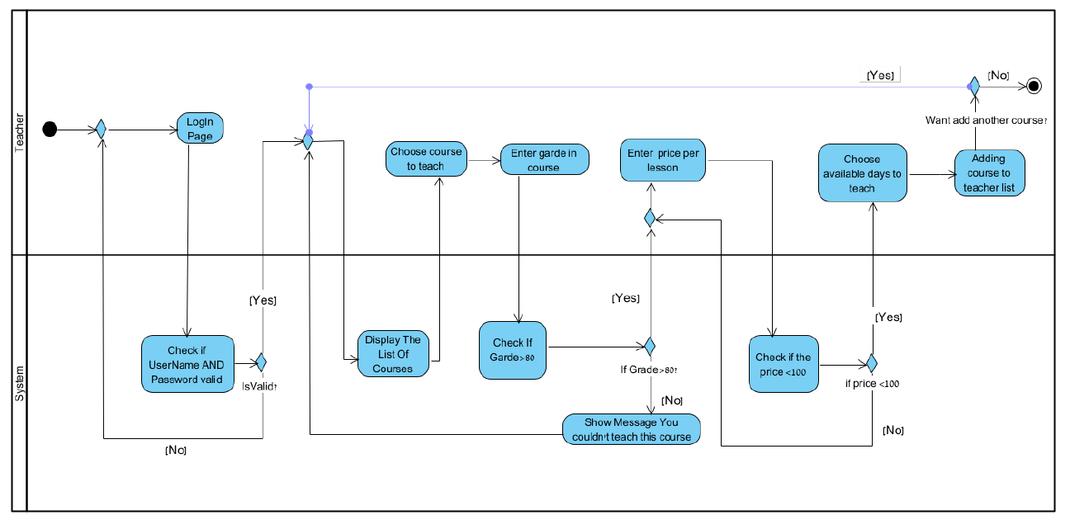
The Product`s
Activity diagram
The process of Adding a course of a teacher—>

Slide 8
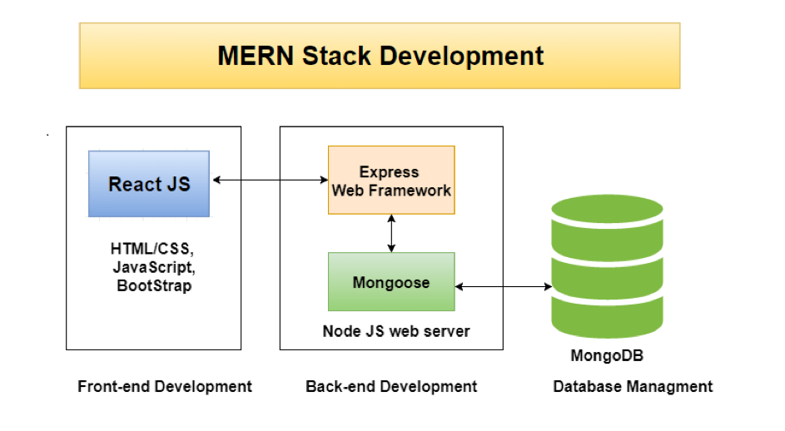
Architecture

Slide 9

Software Infrastructure
These are the programs we used including the versions:
React version 18.2.0
React-Bootstrap version 2.10.1
React-Router version 6.22.1
React-Redux version 9.1.0
Redux-Toolkit version 2.2.1
NodeJS version 21.6.1
MongoDB version 7.0.0
ExpressJS version 4.18.2

Slide 10

Verification
In order to test our system, we will performed two kinds of evaluation tests. The first one is unit testing and the second is functional testing.

Slide 11
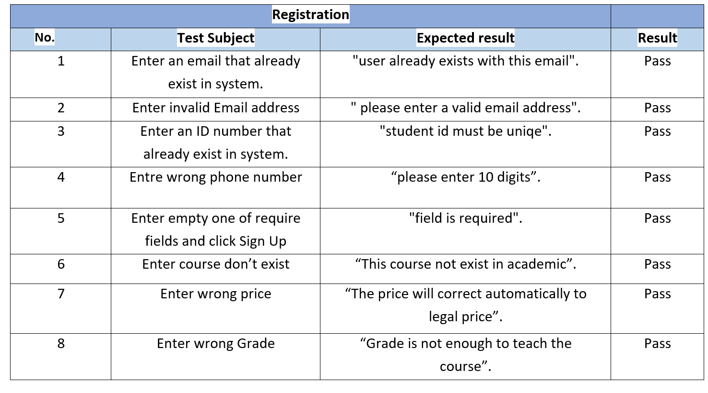
Verification – Unit Testing

Slide 12
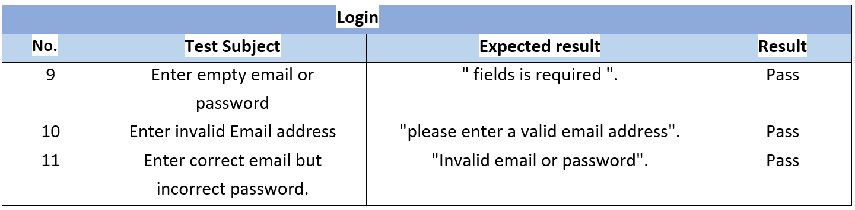
Verification – Unit Testing

Slide 13
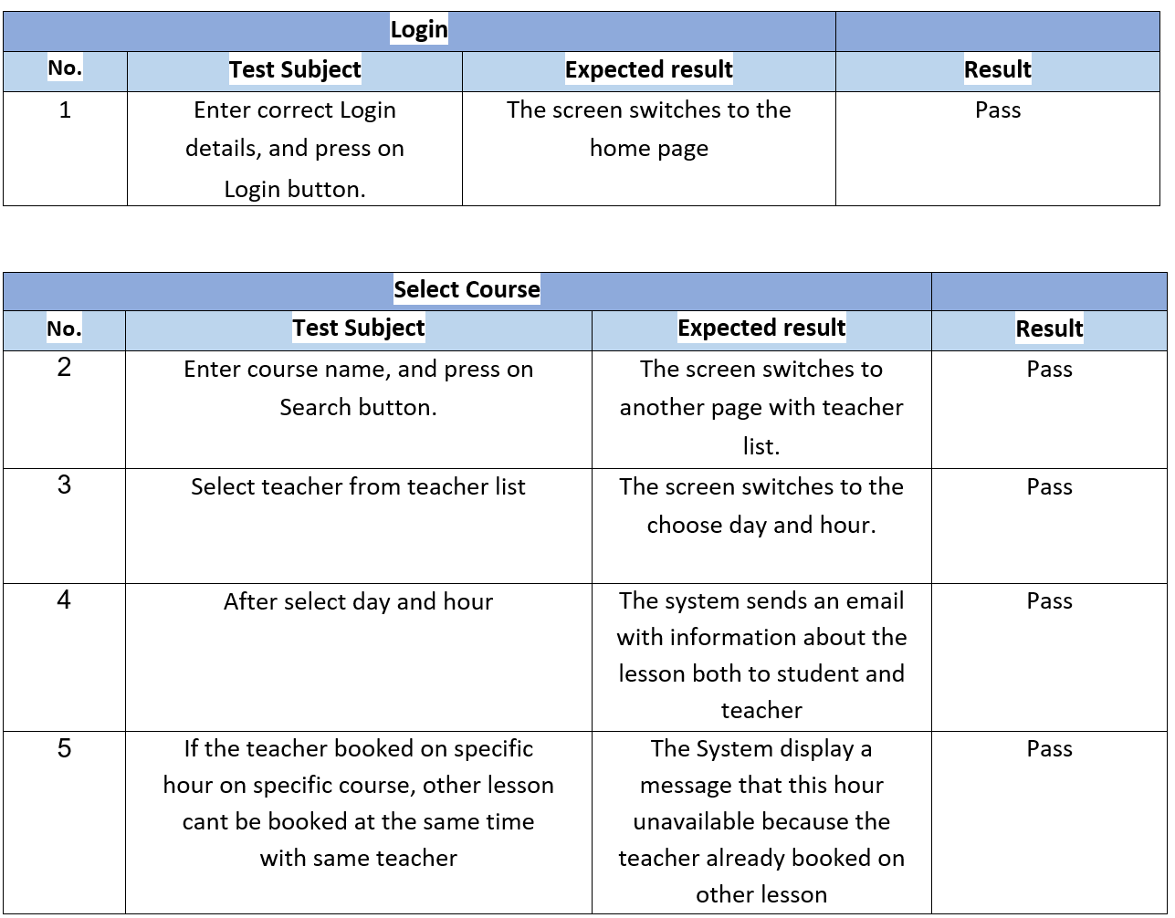
Verification – Functionality Testing

Slide 14
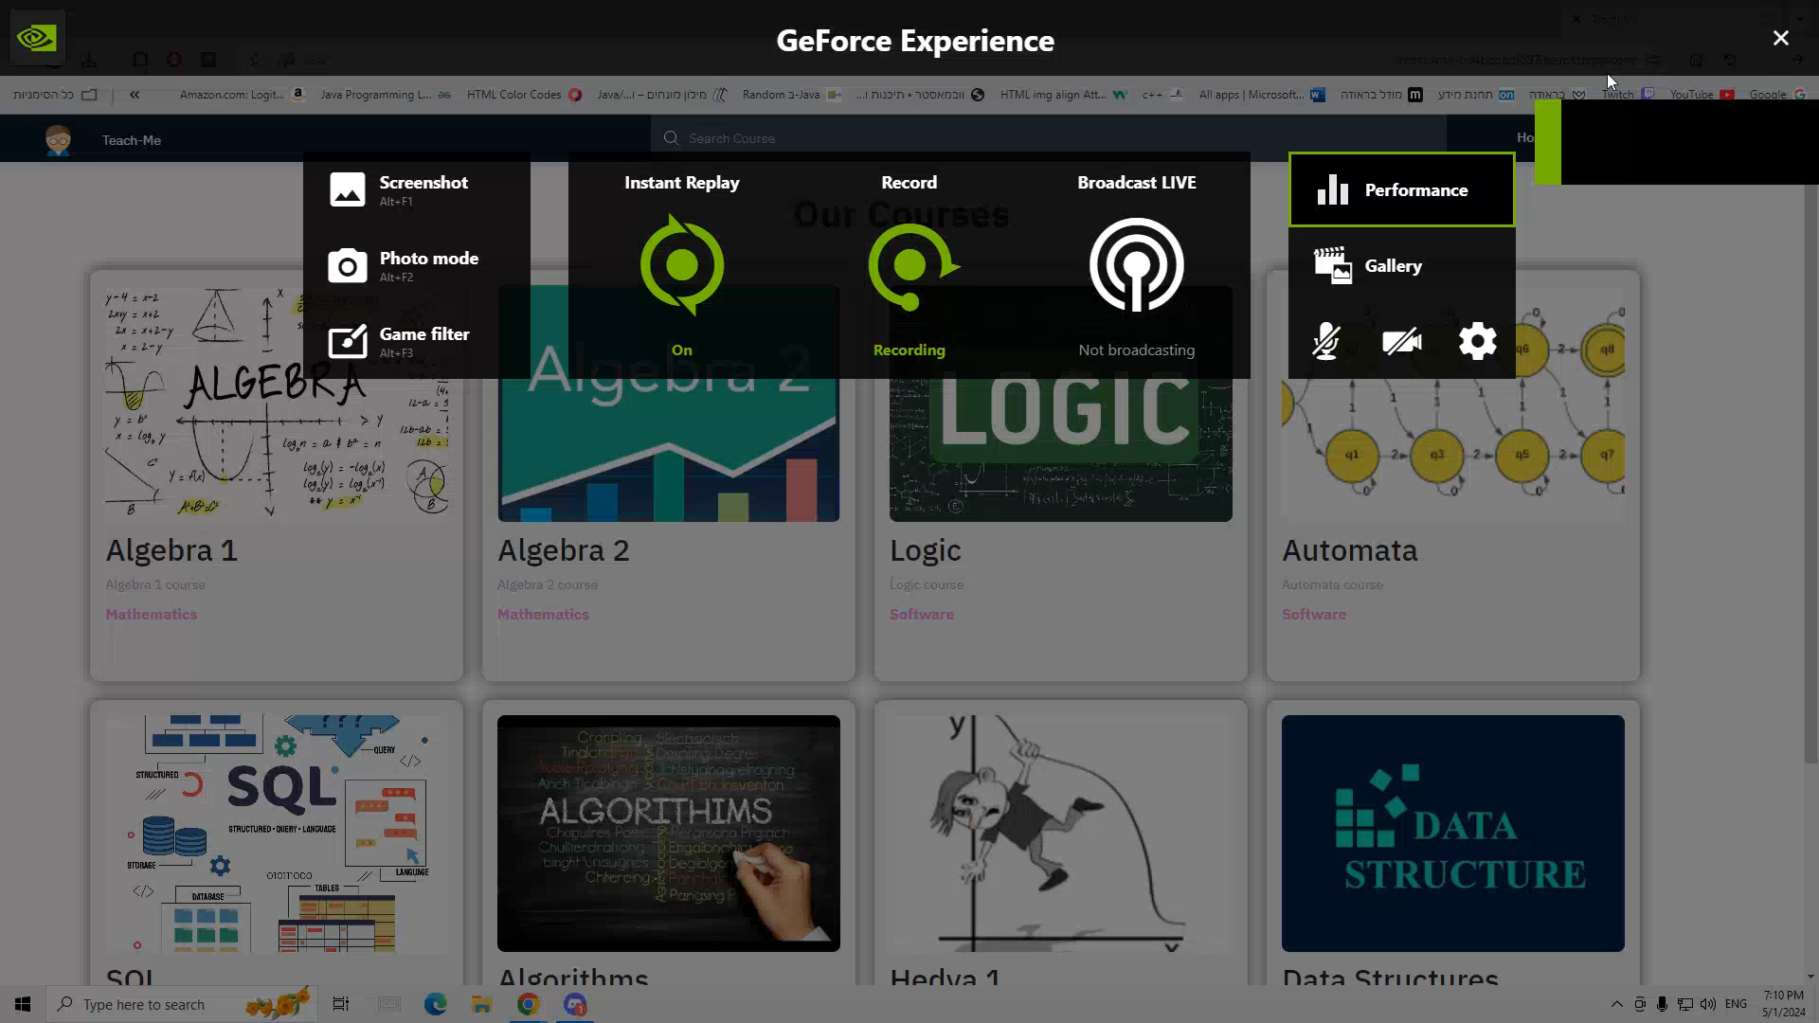
Demonstration

Slide 15

Challenges
Develop a user-friendly, cross-platform application that can operate on a wide range of platforms.
Work with new languages and technologies - NodeJS, React, Express.
During the semester, finding the time to work on the project.

Slide 16

Thank you!
Any questions?

